Slide 1
LLMs in Action: Developing a COM AI Player for an Interactive Tic-Tac-Toe Game using OpenAI Developer API
Lesson 3: Building Modern Web Servers with Flask
Priscilla Emasoga
COM3550 Undergraduate Ambassadors Scheme
University of Sheffield

Slide 2
Overview
What is Flask?
Why use Flask?
Alternative frameworks
The Tic-Tac-Toe AI Web Server
Project structure & features
Key components deep dive
DEMO
Best Practices: Why an Additional Server was Necessary?
COM3550, Undergraduate Ambassadors Scheme
1/14

Slide 3

What is Flask?
What is Flask?
A micro web framework for Python
Used for building APIs, web applications, and microservices.
Ideally can be used to build full-stack applications
We will focus on APIs
Examples of companies using Flask: Netflix, LinkedIn, and Pinterest…
COM3550, Undergraduate Ambassadors Scheme
2/14

Slide 4
Why Flask?
Simple and lightweight
Easy to learn and implement – great for small projects.
Built-in development server and debugger
Production-ready with extensions
Extensions are additional libraries & packages
Installed to enhance functionality
COM3550, Undergraduate Ambassadors Scheme
3/14

Slide 5
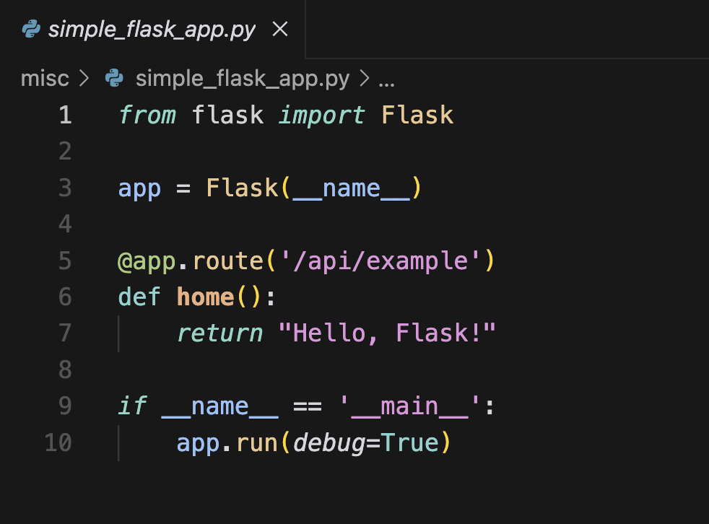
Example: A Simple Flask Application
COM3550, Undergraduate Ambassadors Scheme
4/14

Slide 6

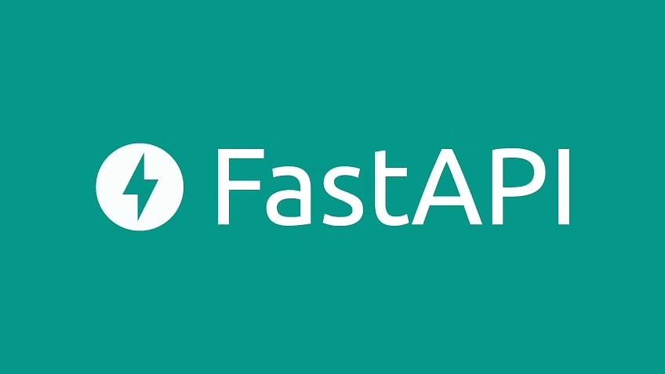
Alternative frameworks
Some other alternative frameworks for web development in Python include:
Django
Older python full-stack web framework
Built-in features e.g Auth, ORM, admin panel,etc
Ideal for complex applications
Fast API
Relatively new and fast rising
Better async support with ASGI
Best for high-performance APIs & real-time apps
COM3550, Undergraduate Ambassadors Scheme
5/14

Slide 7
The Tic-Tac-Toe AI Web Server
COM3550, Undergraduate Ambassadors Scheme
6/14

Slide 8
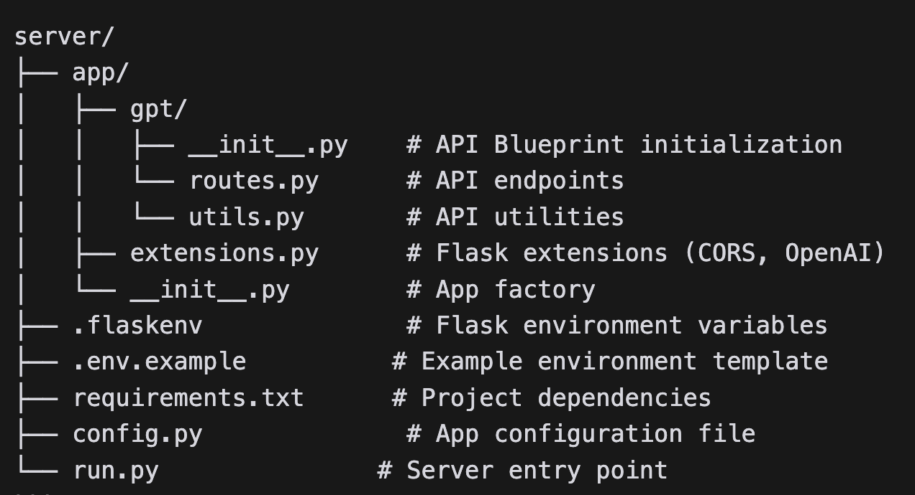
Project structure & features
Flask is lightweight – it doesn’t enforce a strict project structure
i.e do what works best for you
However, a good project structure is crucial for system scalability
Circular imports are a nightmare in python
Our tic-tac-toe server follows the Digital Ocean recommended standard:
Digital Ocean Article ⇒ https://www.digitalocean.com/community/tutorials/how-to-structure-a-large-flask-application-with-flask-blueprints-and-flask-sqlalchemy
COM3550, Undergraduate Ambassadors Scheme
7/14

Slide 9
Key Components Deep Dive
API Endpoints
The server contains only one resource (gpt) and two endpoints
GET: /api/gpt/
Check API status
POST, GET: /api/gpt/move
Uses GPT engine to generate a Tic-Tac-Toe move
params
board - the game nbo
difficulty - used to determine model to use
Extensions
CORS
OpenAI
COM3550, Undergraduate Ambassadors Scheme
8/14

Slide 10
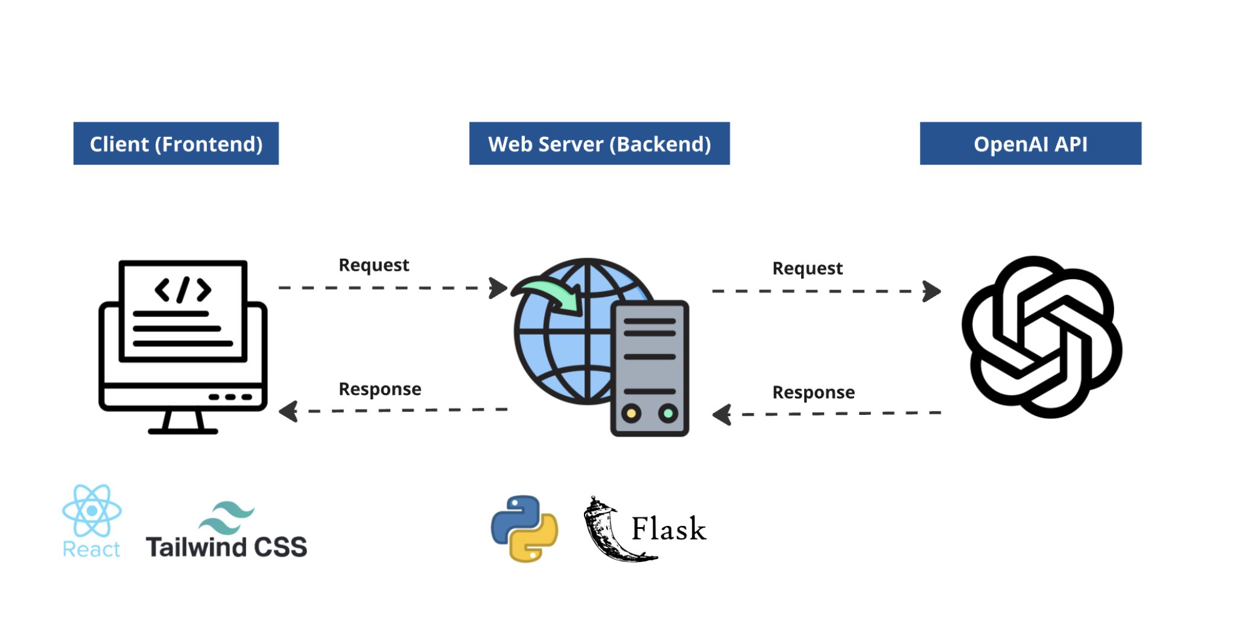
Key Components Deep Dive
AI Integration (How it works)
When a request is sent to /gpt/move endpoint:
API receives request with current board state
Using prompt engineering, the server creates a prompt
Explicitly defines the game’s rules, goal (to win)
and expected output (JSON)
Sends request to OpenAI’s model
Receives the AI’s next move and forwards it to the client
Example Prompt used:
“You are an opponent in a 3x3 Tic-Tac-Toe game. You're playing as 'O' and your goal is to win.
Suggest the indexes of the next move as 'row,col' in JSON format. Do not suggest cells that are already occupied.”
“Given the current Tic-Tac-Toe board: {board} Make the next move for 'O':”
COM3550, Undergraduate Ambassadors Scheme
9/14

Slide 11
DEMO: Web Server
COM3550, Undergraduate Ambassadors Scheme
10/14

Slide 12
Why an Additional Server was Necessary?
OpenAI provides a JavaScript package for direct client-side use, but this bad practice
API Key Security:
API keys in frontend code is a major security risk
Always store them securely on the server using environment variables
Performance Optimization:
Offload computationally expensive tasks to the backend
Efficiently handle multiple concurrent request on the backend
Scalability:
Allows for future expansion with caching, authentication, and monitoring.
Can integrate with additional AI models or databases.
COM3550, Undergraduate Ambassadors Scheme
11/14

Slide 13
Summary
COM3550, Undergraduate Ambassadors Scheme
12/14

Slide 14
Summary
Flask is a lightweight web framework for building APIs.
The Tic-Tac-Toe AI server uses OpenAI model with prompt engineering for move generation.
Additional server integration ensures security, better performance, and scalability.
COM3550, Undergraduate Ambassadors Scheme
13/14

Slide 15
Questions?
COM3550, Undergraduate Ambassadors Scheme
14/14

